Slide 1

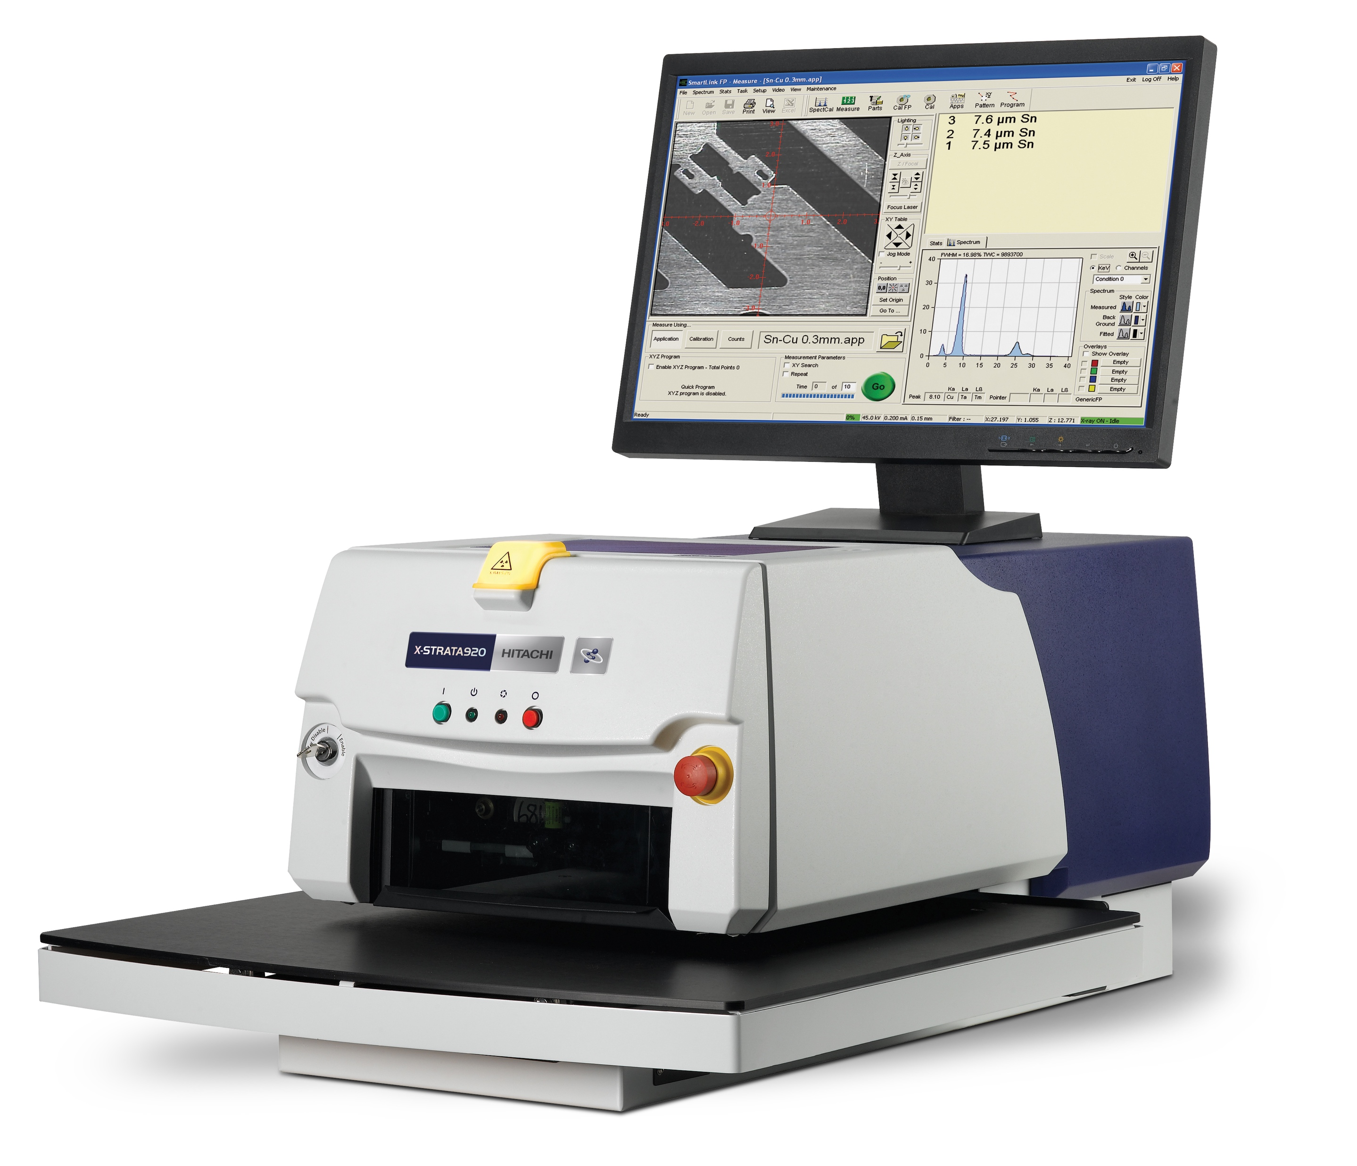
Element range:
Titanium²² to Uranium⁹².
Number of layers and elements:
4 layers + base.
Composition analysis of up to 25 elements simultaneously.
X-ray excitation:
50 W (50 kV and 1.0 mA) micro-focused tungsten anode tube.
X-ray detector:
Power supply:
Xenon-filled proportional counter.
85-130 or 215-265 volts, with frequency range of 47 Hz to 63 Hz.
Collimators:
Working environment:
Single or multiple collimator (up to 6 collimators).
Various sizes from a selection of round, square and rectangular shapes; smallest available: 1 x 2 mil (0.025 x 0.051 mm); largest available: 20 mil round (0.508 mm).
10°C (50°F) to 40°C (104°F) and up to 98% relative humidity, non-condensing.
Secondary beam filters:
Configurations available:
Up to 3 filters for X-ray line overlap corrections
(Vanadium, Cobalt and Nickel).
Standard base
(for parts/components up to 33 mm / 1.3" in height).
Mini-well base
(for parts/components up to 160 mm / 6.3" in height).
XY programmable table; Table travel:
178 mm x 178 mm (7" x 7").
Z travel on all configurations: 43 mm (1.7").
Slotted chamber on all configurations.
Digital pulse processing:
4096-channel digital multi-channel analyser.
Automatic signal processing including dead time correction and pulse pile up rejection.
Dimensions:
Software:
(Without PC and monitor): W x L x H.
Standard fixed base: 407 x 770 x 305 mm
(16 x 30.3 x 12").
Mini-well base: 407 x 770 x 400 mm
(16 x 30.3 x 15.7").
XY motorised base: 610 x 1037 x 375 mm
(24 x 40.8 x 14.8").
Hitachi SmartLink FP.
Languages: English, Chinese (traditional and simplified), French, German, Spanish, Japanese, Korean, Italian, Czech and Russian.
Computer:
Weight:
(Will be equivalent or better).
CPU: Intel Core 2 Duo E7500 2.93 GHz.
500 Gb Hard disk, 2 Gb RAM.
DVDRW.
Microsoft™ Windows operating system.
(Without PC and monitor): 97 kg.

